Slide 1
Geodetic Acoustic Ray Solutions in the Time Domain
Mr. Sean Reilly
University of Rhode Island
Ocean Engineering Department
March 2011

Slide 2
Hypothesis
By revisiting fundamental assumptions of ray theory, we can create a much faster model for real-time, littoral, active sonar sim/stims.
Faster that the speed of sound?
Approach
Use time domain ray trace to improve continuity of wavefront with fewer rays.
Use 3-D spherical coordinates (lat, long, alt) to avoid translation of environmental data into 2-DxN.
Use Gaussian beams to improve performance in shadow zones and at lower frequencies.

Slide 3
Progress Report
1st draft of implementation is working.
Now looking for weaknesses using analytic models and classic benchmarks.

Slide 4
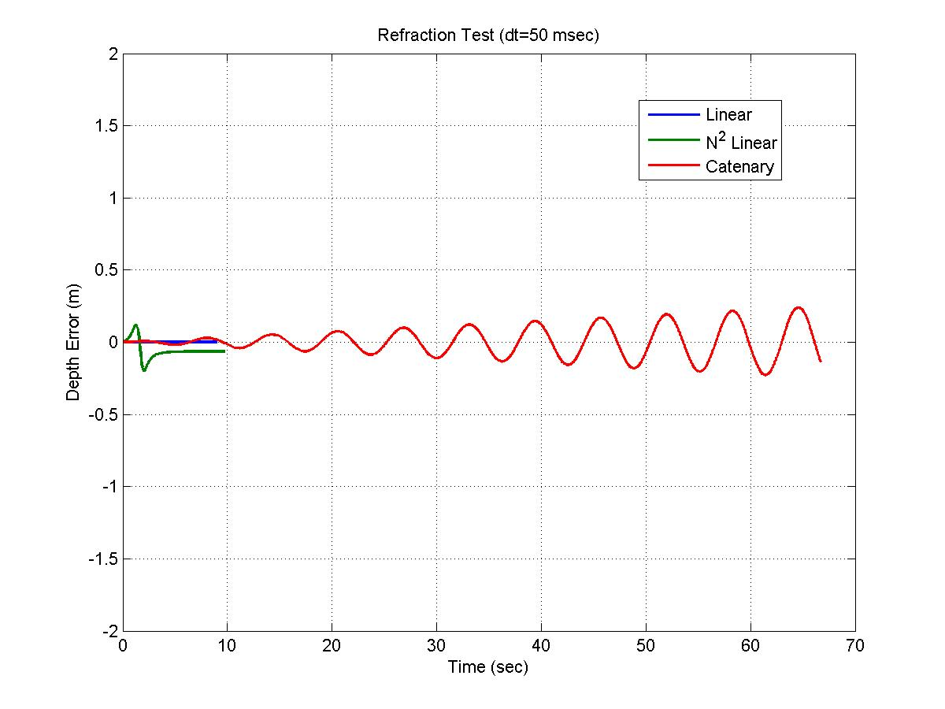
Refraction Accuracy Tests

Slide 5
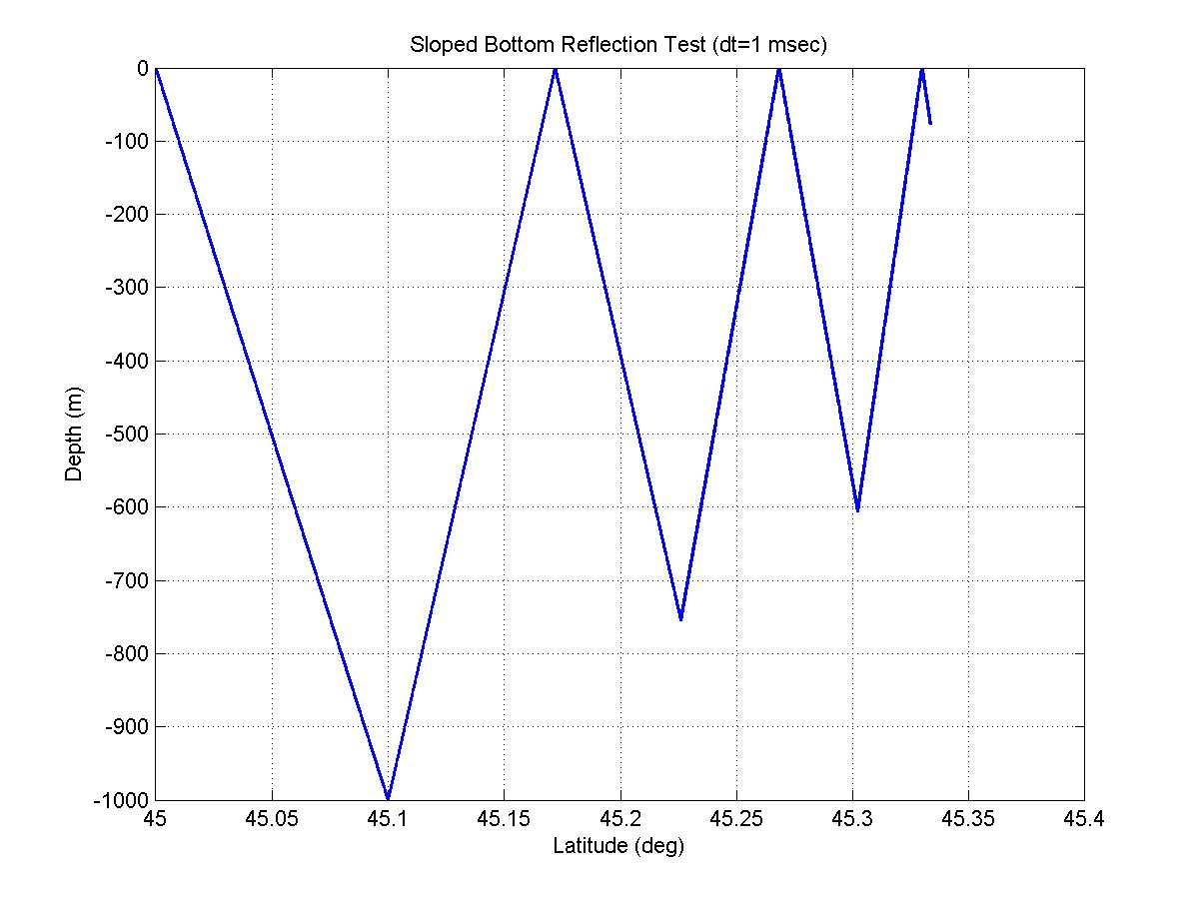
Reflection Accuracy Tests

Slide 6
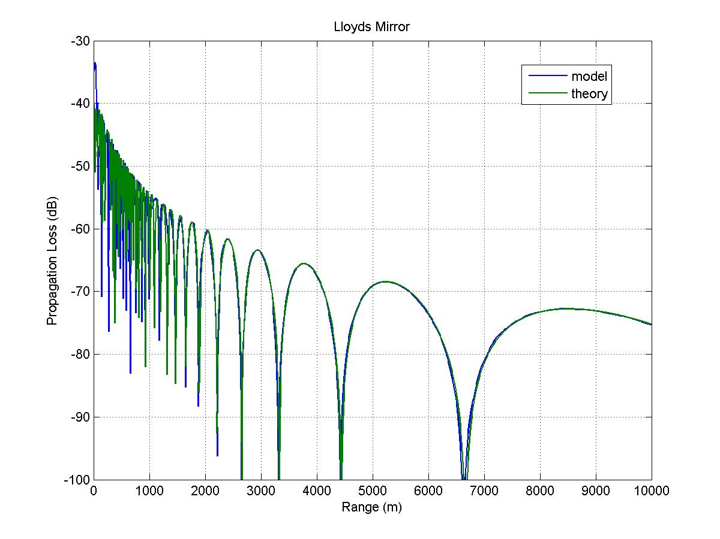
Lloyd's Mirror Test
Source: 25 meters deep
Target: 25 meters deep
Frequency: 2000 Hz
Time Step: 50 msec
Flattened Earth, Classic Ray Theory

Slide 7
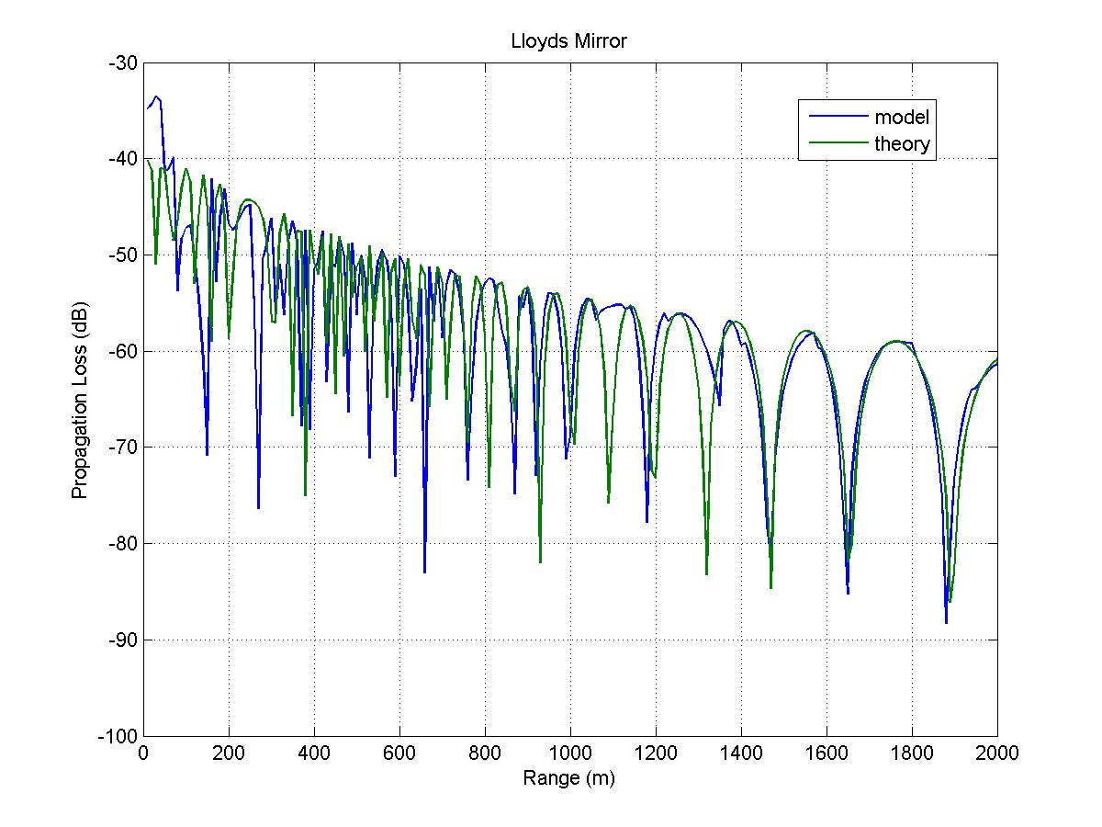
Lloyd's Mirror Close-up
Source: 25 meters deep
Target: 25 meters deep
Frequency: 2000 Hz
Time Step: 50 msec
Flattened Earth , Classic Ray Theory

Slide 8
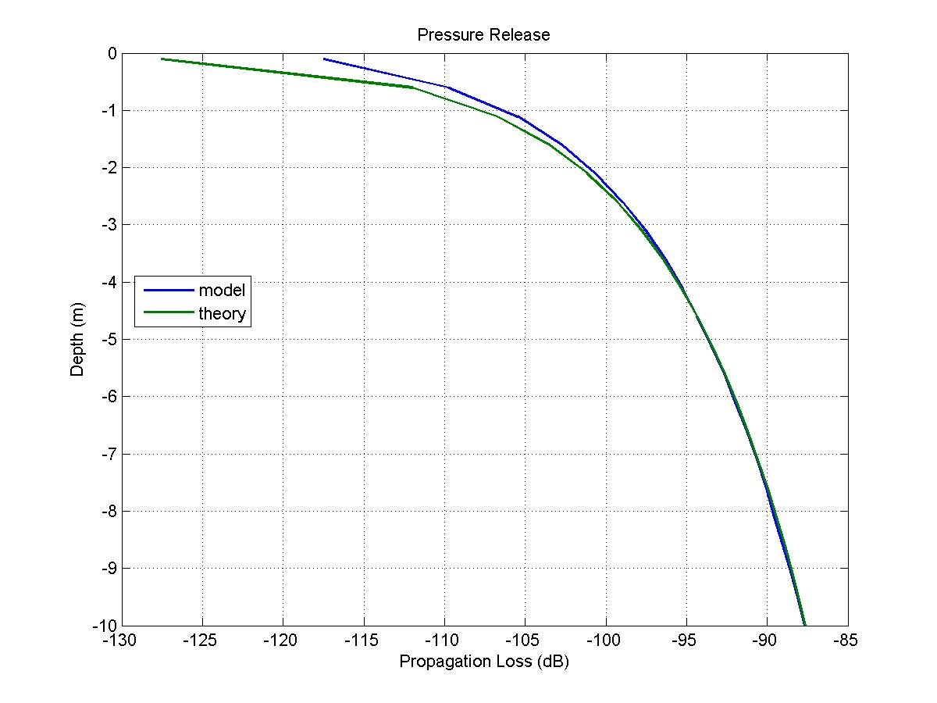
Pressure Release Test
Source: 25 meters deep
Target: 10 km away
Frequency: 2000 Hz
Time Step: 50 msec
Flattened Earth , Classic Ray Theory

Slide 9
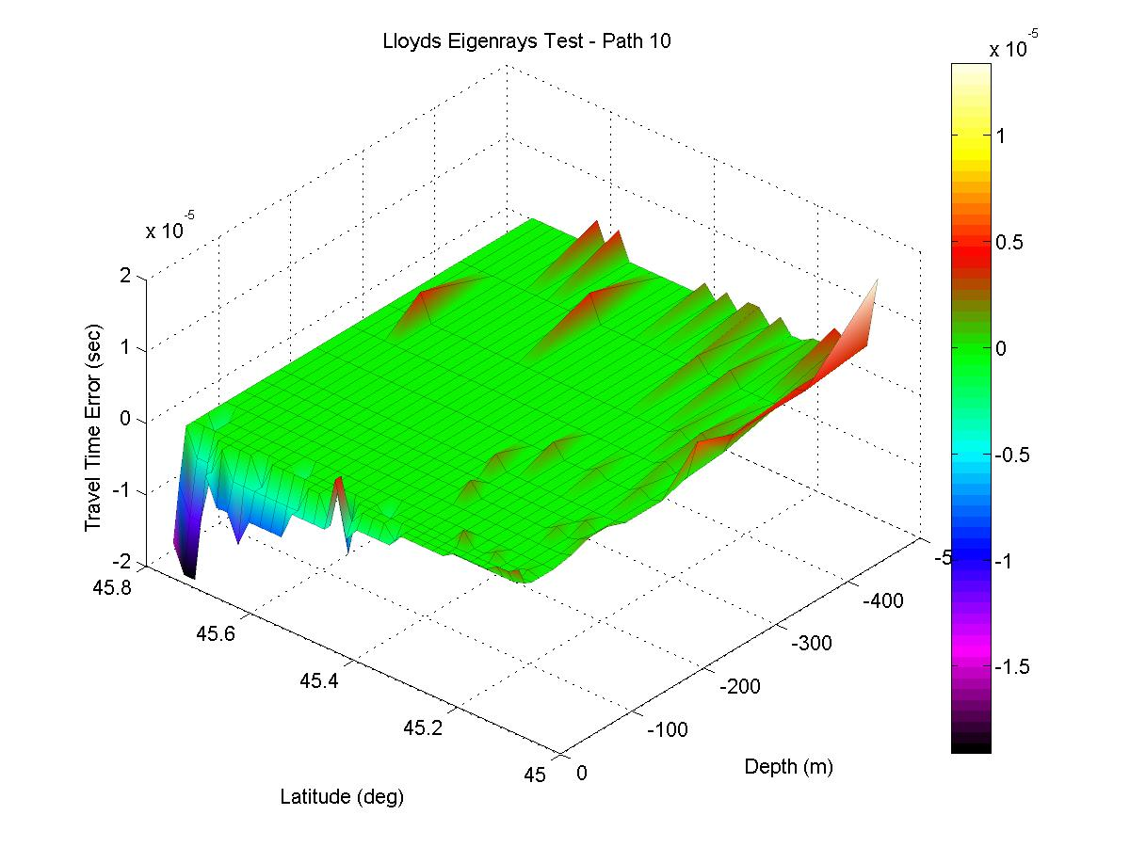
Lloyd's Mirror on Round Earth
Source: 25 meters deep
Frequency: 2000 Hz
Time Step: 50 msec
Round Earth , Classic Ray Theory
x 10⁻⁵
weakness
near vertical
weakness
near surface

Slide 10
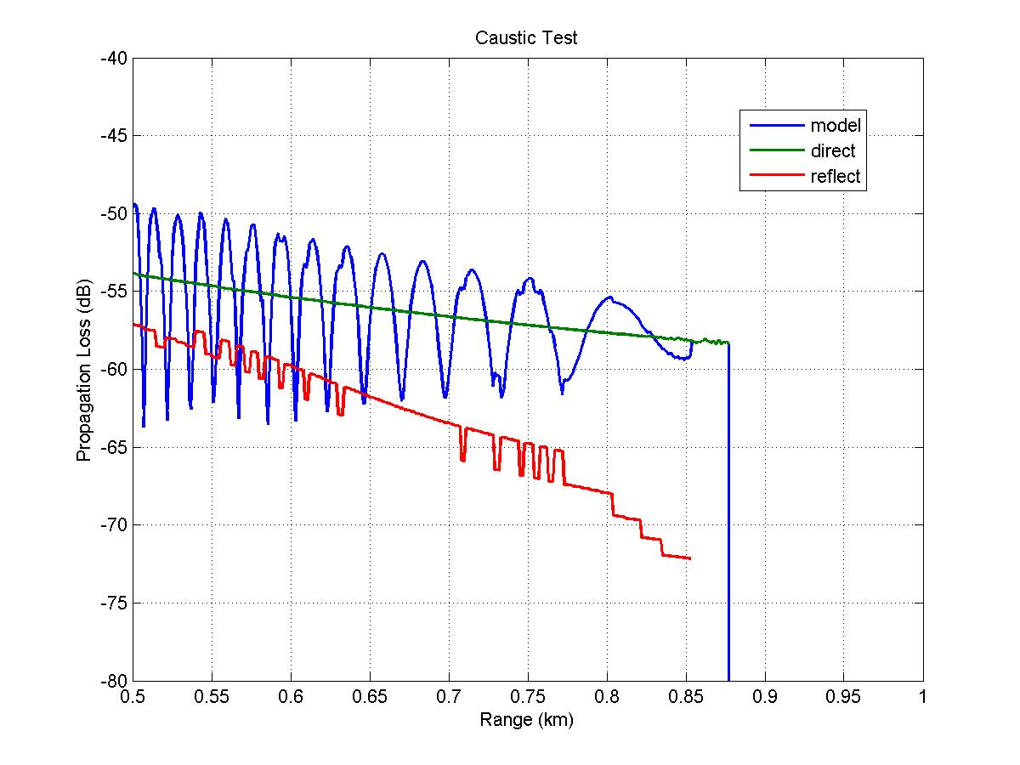
N² Linear w/ Shallow Source
Test case from Jensen, Kupperman,
et. al.
Source: 75 meters deep
Target: 75 meters deep
Frequency: 2000 Hz
Time Step: 50 msec
Flattened Earth , Classic Ray Theory

Slide 11
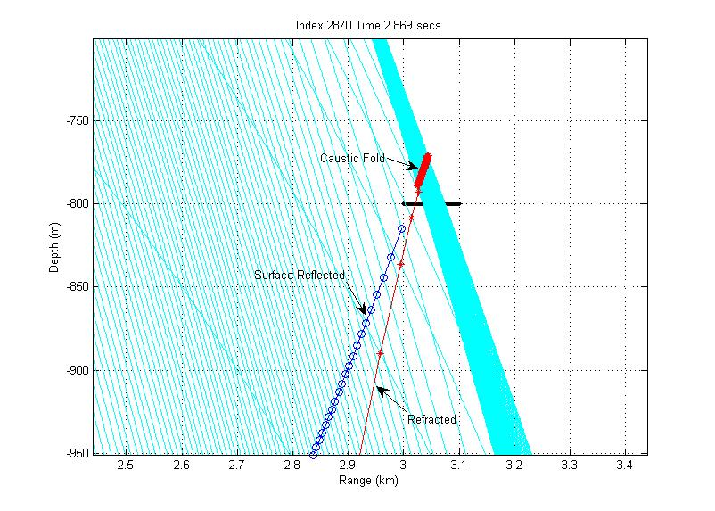
N² Linear w/ Deep Source
Test case from Jensen, Kupperman,
et. al.
# of bounces doesn’t predict all turning points

Slide 12
For next time
Eliminate assumption that there can only be one eigenray for each combination of reflections and vertices
Use wavefront direction changes to define turning points and ray bundles.
Develop an analytic model for surface reflected TL on round earth.
Develop an analytic solution for the N² Linear test case from Jensen, Kupperman, et. al.

